Slide 1
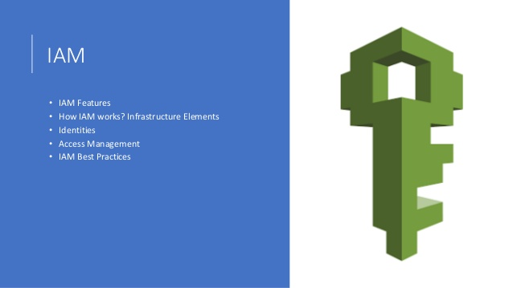

Slide 2
IAM (Identity & Access Management)
IAM Refers to a framework or Policies and technologies for ensuring that the
proper people in an Organisation have the appropriate access to technology
resources.
OR
AWS Identity and access Management is a web service that helps you securely
control access to AWS Resource you use IAM to Control who is authenticated
(Signed in ) and authorized (has permission) to use resouces.

Slide 3
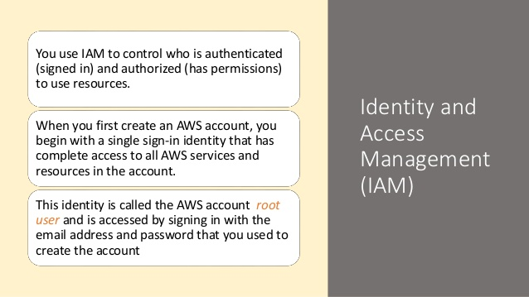

Slide 4
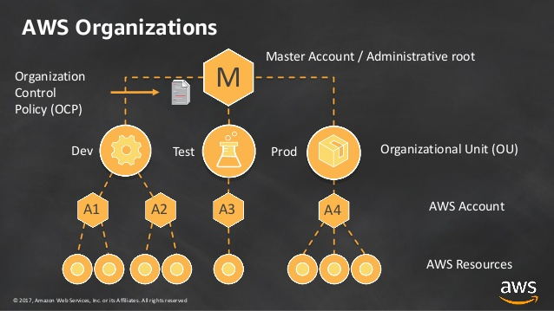

Slide 5
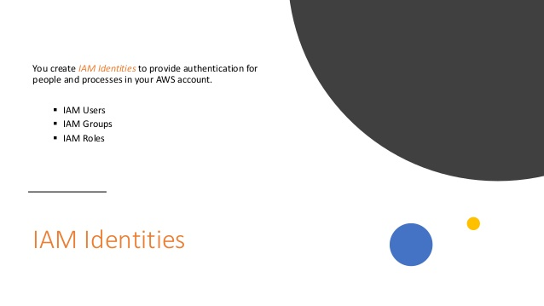

Slide 6
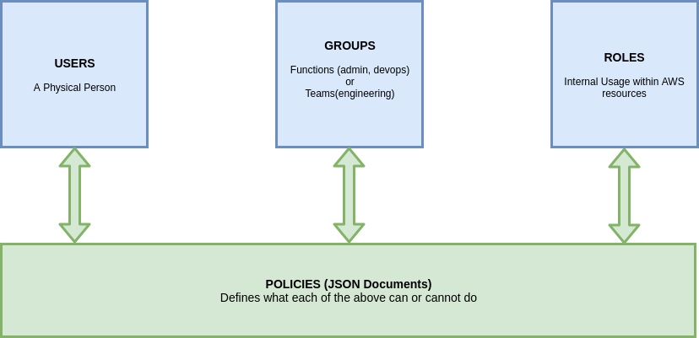

Slide 7
